Slide 1
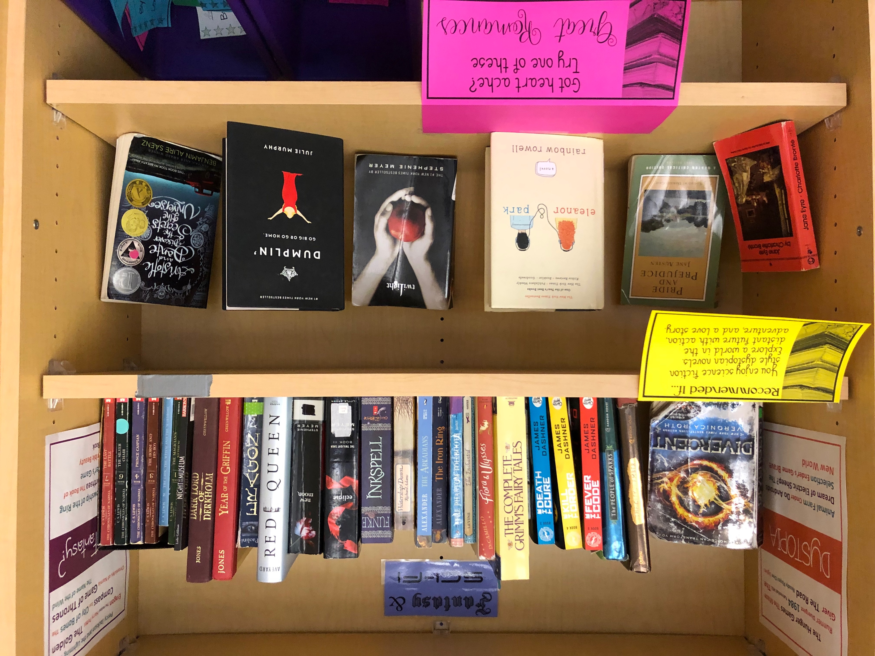
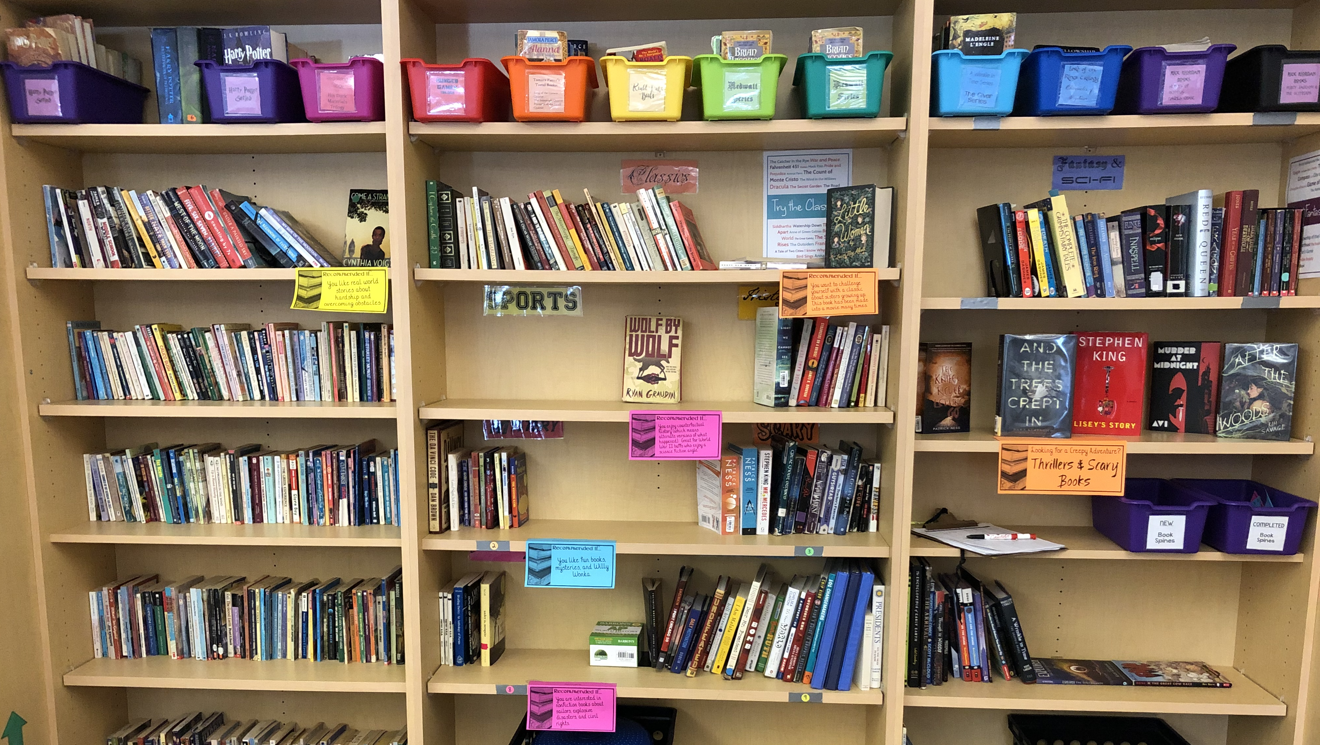
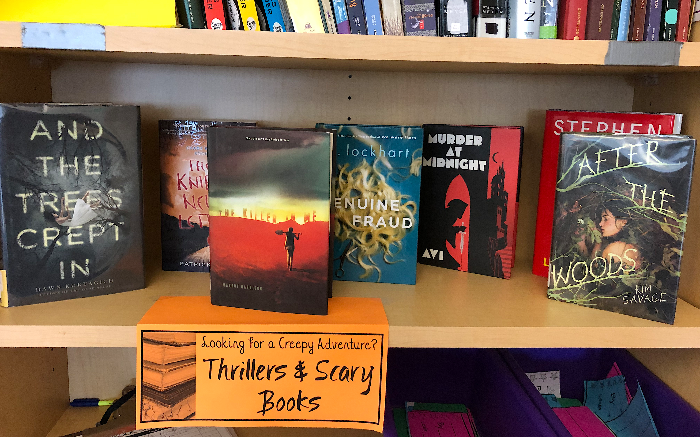
Dear Teacher,
Thank you for downloading the Library Recommendation Cards. This resource is meant to help you make your classroom library more enticing for your readers.
There are two sizes of recommendation cards included along with some templates for long display cards. I print these on bright paper and use these to hang off the shelves beneath the books. There are some example photos from my classroom below.
I have found students are much more interested in books that are on display, especially when I take a moment at the beginning of class every week or so to highlight new books.
Terms of Use: This resource is intended for personal and educational use only. Feel free to share with a link to my TPT Store. You may not sell this resource as your own. Created by Alexandra Stewart 2019.
https://www.teacherspayteachers.com/Store/Alexandra-Stewart
I hope you enjoy this product. Please feel free to leave a review and follow my store for more resources.
Always,
Ms. Stewart
Examples of my Display Shelf
My classroom library book shelves.
*Please note, the font used for writing recommendations is KG A Thousand Years available from Kimberly Geswein Fonts at: https://www.teacherspayteachers.com/Store/Kimberly-Geswein-Fonts

Slide 2
Book Title
Explanation
Book Title
Explanation

Slide 3
Explanation
Book Title
Book Title
Explanation
Explanation
Book Title
Book Title

Slide 4
Wolf By Wolf
You enjoy counterfactual history (which means alternate versions of what happened). Great for World War II buffs who enjoy a science fiction angle.
We Were Liars
You want a good cry. This is an intense book of teenagers with lots of secrets which are revealed bit by bit.

Slide 5
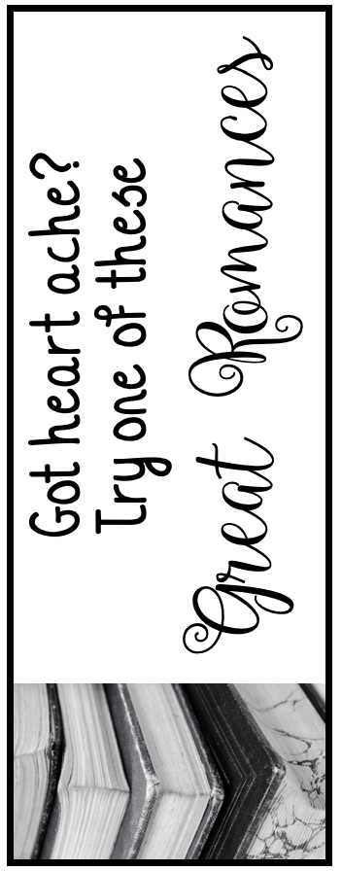

Slide 6
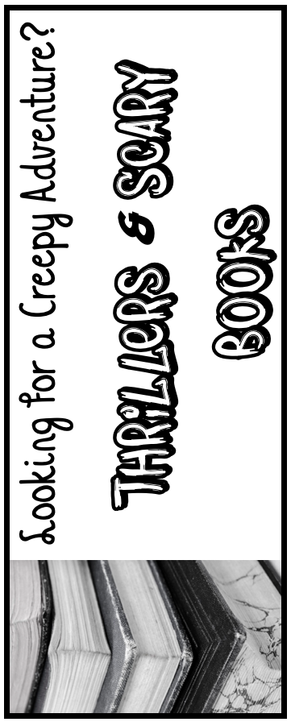

Slide 8
Question?
GENRE

